Slide 1
Lockable Signatures for Blockchains: Scriptless Scripts for All Signatures
S&P 2021
Sri Aravinda Krishnan Thyagarajan
Friedrich Alexander Universität Erlangen-Nürnberg
Giulio Malavolta
Max Planck Institute for Security and Privacy

Slide 2
Outline
Background
Hash Time-Lock Contracts (HTLC)
Anonymous multi-hop locks (AMHL)
Lockable Signatures

Slide 3
1. Background

Slide 4
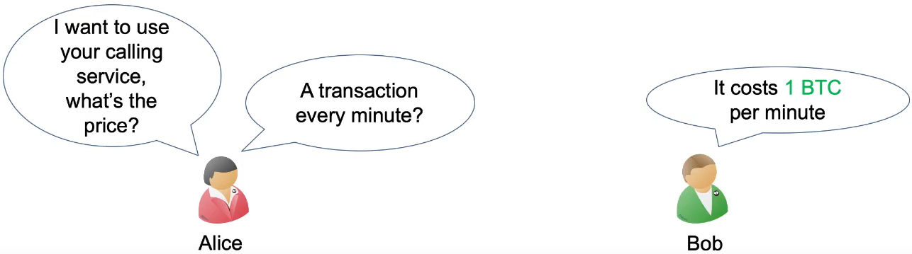
Cryptocurrency Micro-Payment

Slide 5
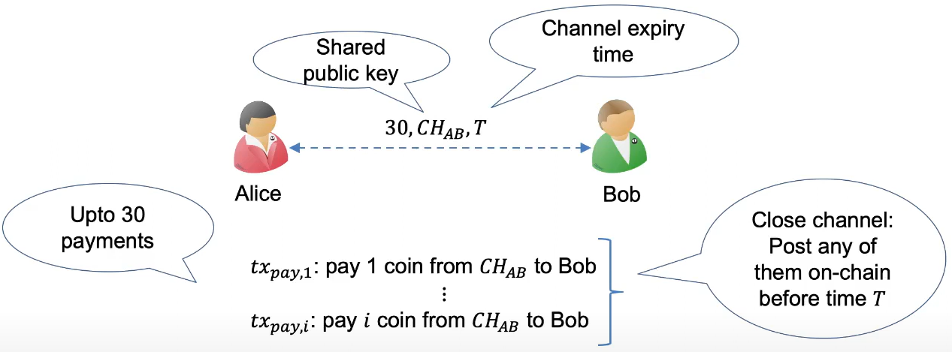
Payment Channel (PC)

Slide 6





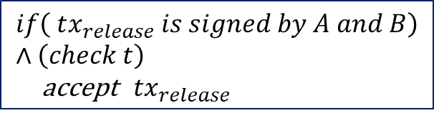



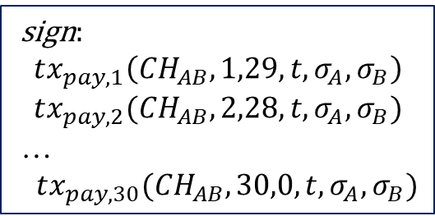

Micropayment - Script
$$if\left( tx_{release} is signed by A and B\right)∧\left(check t\right)$$
accept $tx_{release}$
$$CH_{AB}$$
Lock
$$tx_{lock}(A,CH_{AB},30,script,T)$$
1st min service
sign:
$$tx_{pay,1}\left(CH_{AB},1,29,t,σ_{A},σ_{B}\right)$$
$$tx_{pay,2}(CH_{AB},2,28,t,σ_{A},σ_{B})$$
…
$tx_{pay,30}(CH_{AB},30,0,t,σ_{A},σ_{B})$
$$tx_{pay,1}(CH_{AB},1,29,t,σ_{A})$$
2nd min service
Off-chain payment
$$tx_{pay,2}(CH_{AB},2,28,t,σ_{A})$$
……
30th min service
Release
$$tx_{pay,30}(CH_{AB},30,0,t,σ_{A})$$
B uploads$tx_{release}=tx_{pay,i}$

Slide 7
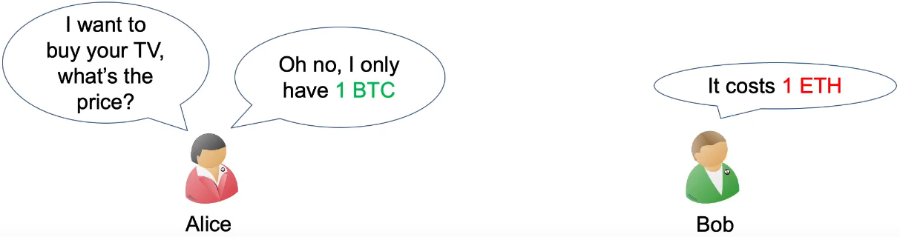
Cross Currency Payment

Slide 8
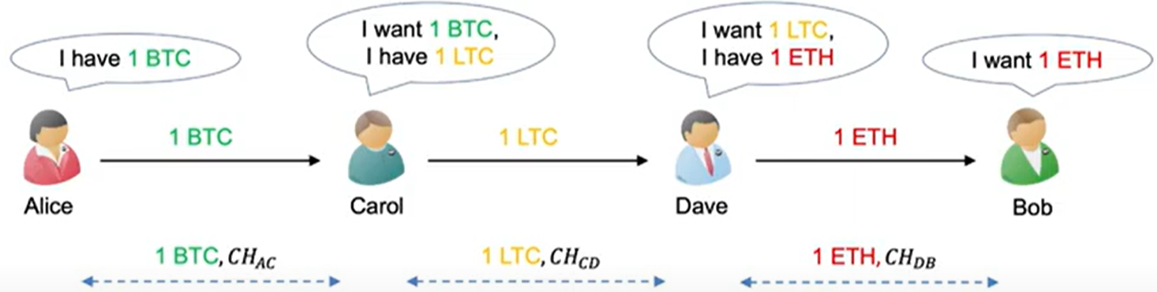
Payment Channel Network (PCN)
Atomicity
Balance Security

Slide 9
2. Hash Time-Lock Contracts

Slide 10








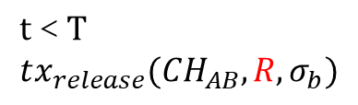

HTLC (Hash Time-Lock Contracts)
$$CH_{AB}$$
$$4.tx_{lock}(A,CH_{AB},v, T,h,script,σ_{a})$$
$$1.CH_{AB}$$
$$2.h=H(R)$$
$$3.h$$
Lock
Release
$$CH_{AB}$$
$$t＜T \\ tx_{release}(CH_{AB}, R,σ_{b})$$
$$t≥T$$
$$v$$
$$v$$

Slide 11
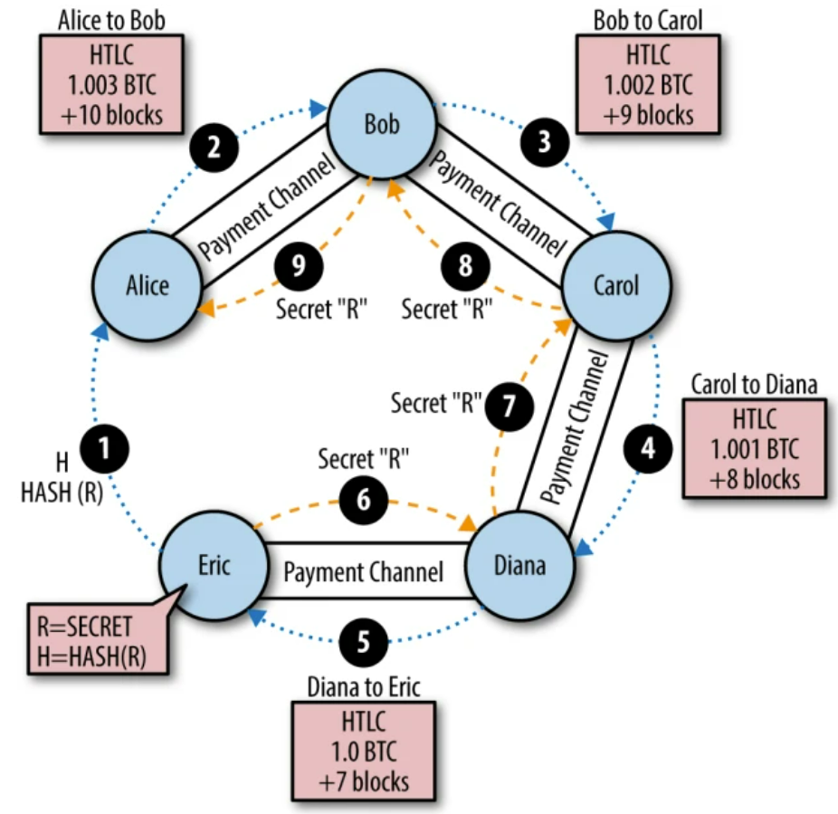
PCN-HTLC

Slide 12
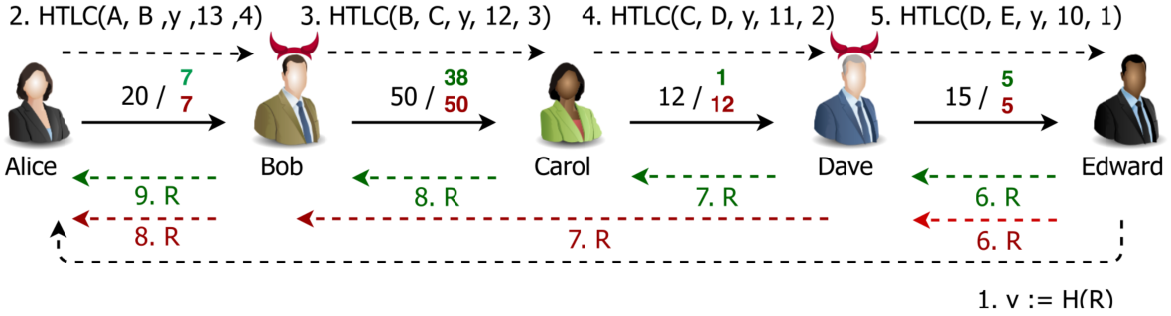
Wormhole Attack
Normal process
Wormhole Attack

Slide 13
Conclusion - HTLC
Limitation:
It suffers from wormhole attacks
It is compatible only with those blockchains that support advanced scripts and several existing currencies like Monero, Mimblewimble, Ripple or Zcash are therefore left out
It results in larger transactions and consequently larger ledgers
It lacks on-chain privacy as PCN transactions of a single payment are linkable with each other

Slide 14
3. Anonymous multi-hop locks

Slide 15
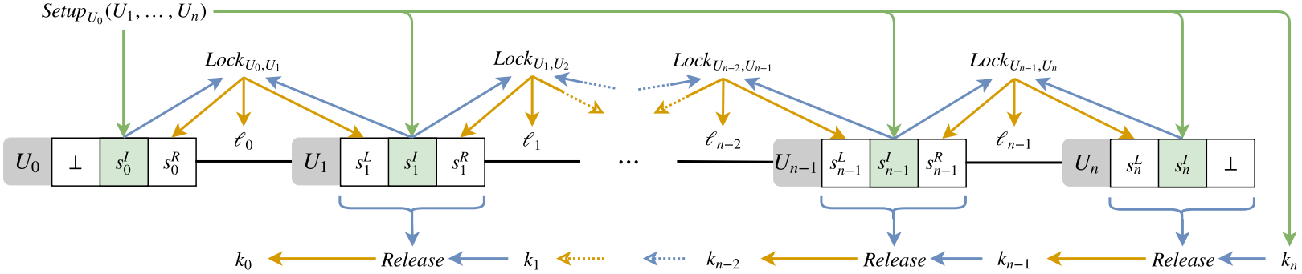
Anonymous multi-hop locks (AMHL )
Script | Scriptless
Homomorphic One-Way Functions | Schnorr-based Construction | ECDSA-based Construction
G. Malavolta, P. Moreno-Sanchez, C. Schneidewind, A. Kate, and M. Maffei, “Anonymous multi-hop locks for blockchain scalability and interoperability,” in NDSS 2019, The Internet Society, Feb. 2019

Slide 16
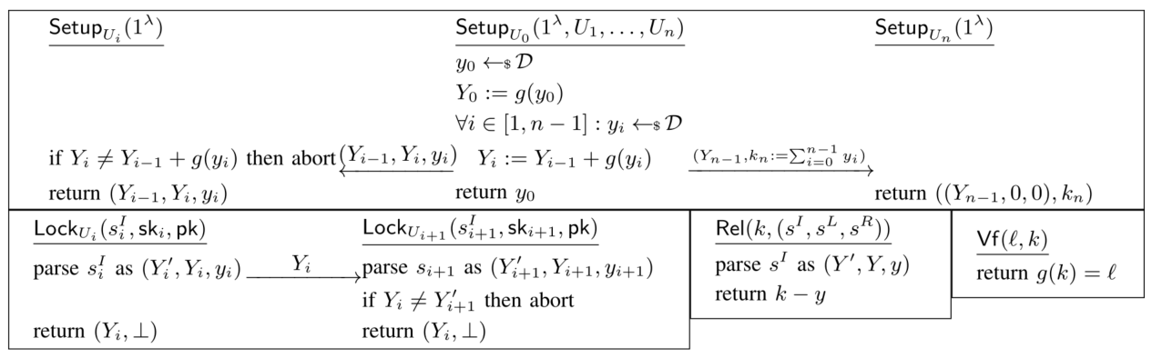
AMHL - Homomorphic One-Way Functions

Slide 17
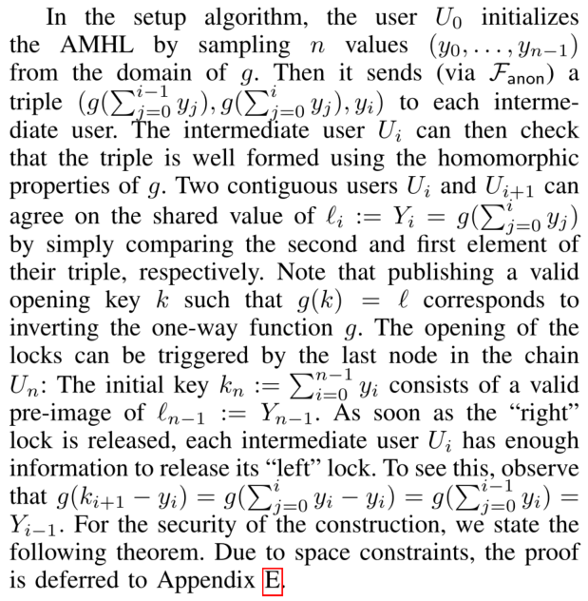







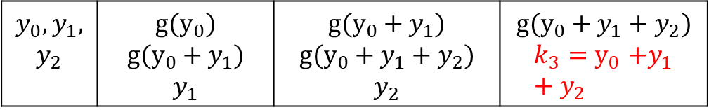






AMHL - Homomorphic One-Way Functions
$${g(y}_{0})$$
$${g(y}_{0}+y_{1})$$
$${g(y}_{0}+y_{1}+y_{2})$$
$$U_{0}$$
$$U_{1}$$
$$U_{2}$$
$$U_{3}$$
$$y_{0},y_{1},$$ $$y_{2}$$ | $${g(y}_{0})$$ $${g(y}_{0}+y_{1})$$ $$y_{1}$$ | $${g(y}_{0}+y_{1})$$ $${g(y}_{0}+y_{1}+y_{2})$$ $$y_{2}$$ | $${g(y}_{0}+y_{1}+y_{2})$$ $$k_{3}{=y}_{0}+y_{1}+y_{2}$$
$$k_{3}$$
$$k_{2}=k_{3}−y_{2}$$
$$k_{2}$$
$$k_{1}=k_{2}−y_{1}$$
$$k_{1}$$

Slide 18


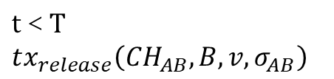










Scriptless Script
$$CH_{AB}$$
$${pk}_{AB}=\left({sk}_{a}+sk_{b}\right)P$$
$$2. tx_{lock}\left(A,AB,v,T,σ_{a}\right)$$
$1. AB$ address
lock
$${sk}_{a}$$
$${sk}_{b}$$
Release
$$CH_{AB}$$
$$t＜T \\ tx_{release}\left(CH_{AB},B,v,σ_{AB}\right)$$
$$t≥T$$
$$v$$
$$v$$
$$k$$
$${sk}_{a}$$
$${sk}_{b}$$

Slide 19
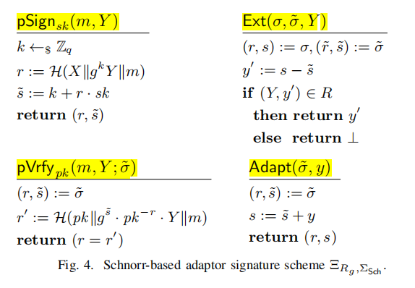
Adaptor Signature

Slide 20
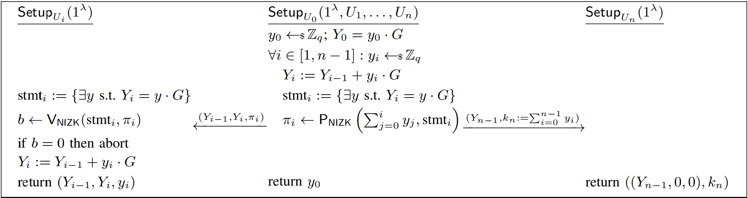
AMHL - Schnorr-based construction

Slide 21
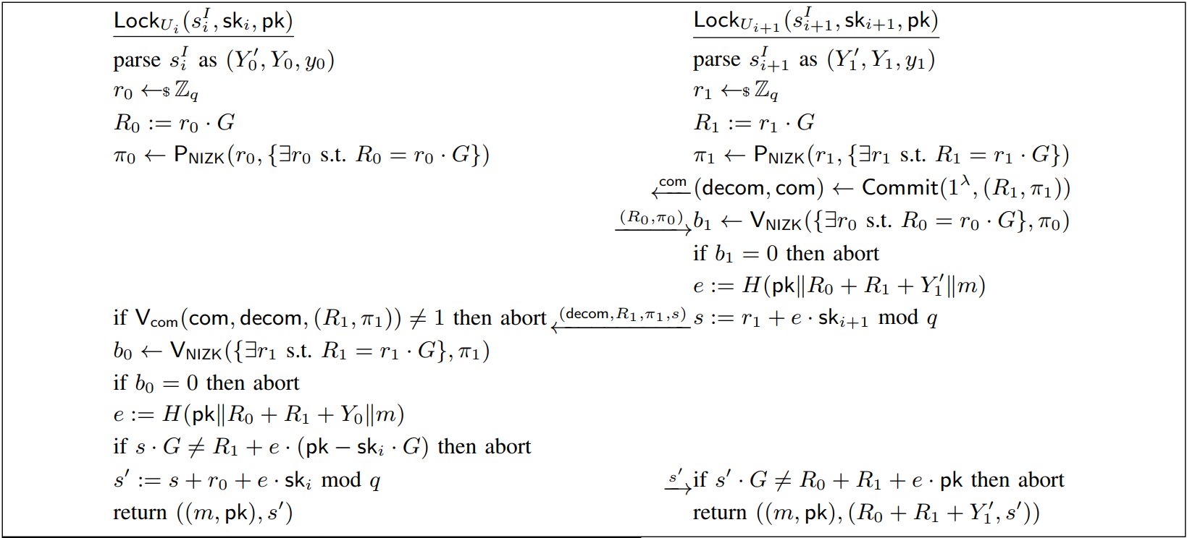
AMHL - Schnorr-based construction

Slide 22
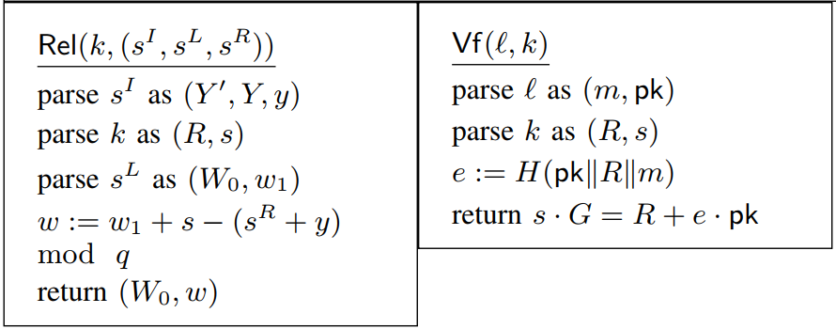
AMHL - Schnorr-based construction

Slide 23
Conclusion - AMHL
Adversary:
Realize in a scriptless setting
Construct secure and privacy-preserving PCNs
Limitation:
Only support a handful of digital signature scheme, such as Schnorr or ECDSA signatures

Slide 24
4. Lockable Signatures

Slide 25
Contribution
Compatibility: All signature scheme (MPC)
Efficiency: Ultra fast protocol for BLS signature
Privacy: Regular payment = Conditional payments

Slide 26
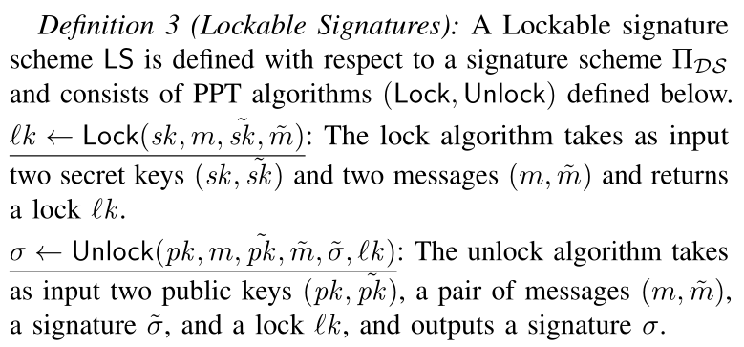
Lockable Signatures
A lockable signature scheme allows one to lock a signature (referred to as the locked signature) on a message with respect to another signature (referred to as the locking signature), possibly on a different message.

Slide 27
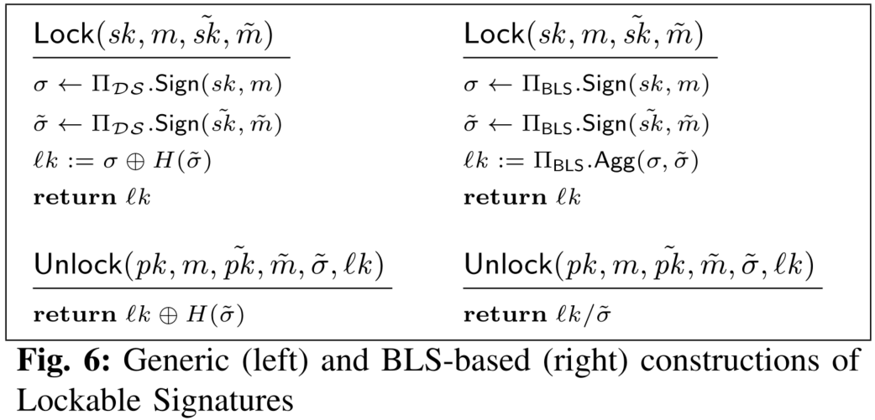
Lockable Signatures

Slide 28
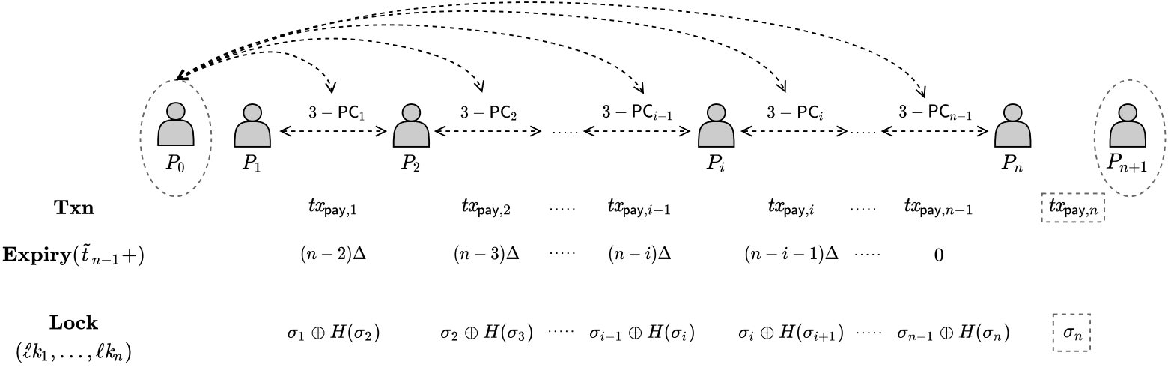
Technical Overview

Slide 29
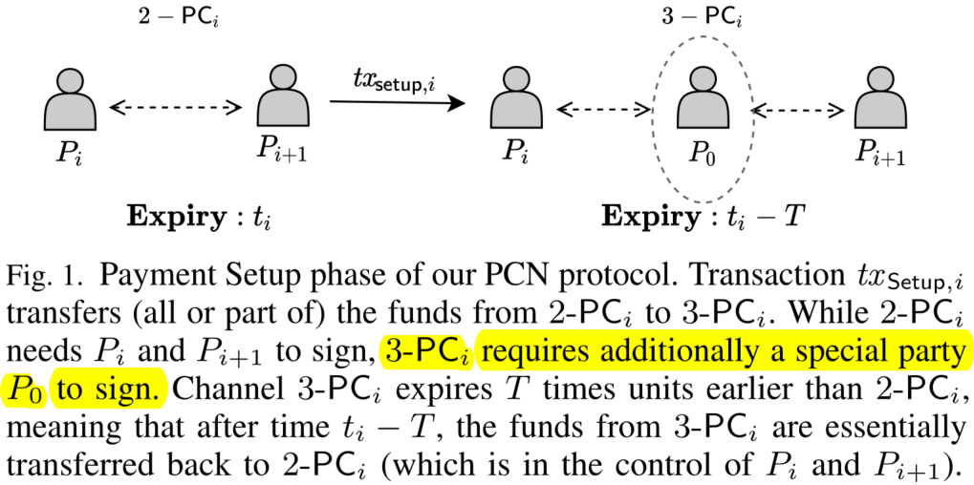
Technical Overview

Slide 30
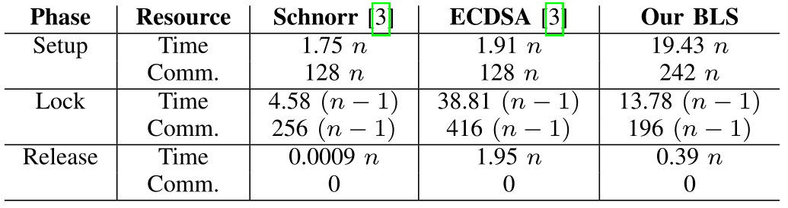
Efficiency Analysis

Slide 31
Conclusion - Lockable Signatures
Not require any special scripts
Compatible with any signature scheme
Expands the scope of PCNs to signature schemes with extra properties (e.g. post-quantum secure)
An efficient BLS-based PCN protocol

Slide 32
THANK YOU!

